Slide 1
Network of Computers
18ESC108A Elements of Computer Science and Engineering
B. Tech. 2018
Ami Rai E.
Roopa G
Chaitra S
Department of Computer Science and Engineering
Faculty of Engineering and Technology
Ramaiah University of Applied Sciences

Slide 2
Objectives
At the end of this lecture, student will be able to
Describe the basic concepts and importance of
Network of computers
Distributed computing
High performance computing
Cloud computing
Internet and Web technology
explain the benefits of each technology

Slide 3
Topics
Network of computers
Distributed computing
High performance computing
Cloud computing
Internet and Web technology

Slide 4
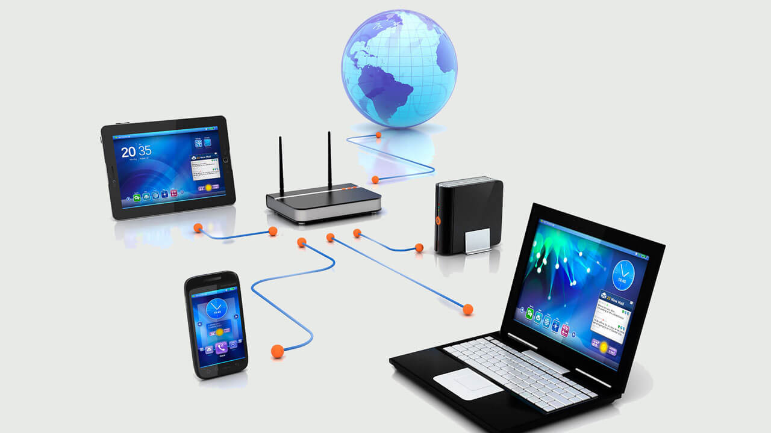
Network of Computers
Network computers are the computers that are connected to each other through a network
To share their information and resources
Devices termed as routers, switches and firewalls are used to connect, create and protect the network respectively

Slide 5
Distributed Computing
A distributed system is one in which components located at networked computers communicate and coordinate their actions only by passing messages
A distributed system is characterized by multiple processes that are spatially separated and are running independently
The sharing of resources is a main motivation for constructing distributed systems
E.g., the Web
Resources may be managed by servers and accessed by clients or they may be encapsulated as objects and accessed by other client objects

Slide 6
Distributed Computing Examples
Internet
Intranet
WWW
Airline reservation system
Sensor networks
Electronic banking etc.,

Slide 7
High Performance Computing
High Performance Computing (HPC) allows scientists and engineers to solve complex, compute-intensive problems
HPC applications often require
High network performance
Fast storage
Large amounts of memory
Very high compute capabilities

Slide 8
HPC - Examples
Data analytics
Artificial intelligence
Supercomputers

Slide 9
Cloud Computing
Why should we buy a printer when we need printing occasionally?
Is it possible to avail computing on “need basis” as it is possible in case of “electricity” or “water?
Can we avail computing resources such as storage, application, and infrastructure as a “utility”?
Cloud Computing refers to manipulating, configuring, and accessing the applications online
Cloud computing offers online data storage, infrastructure and application

Slide 10
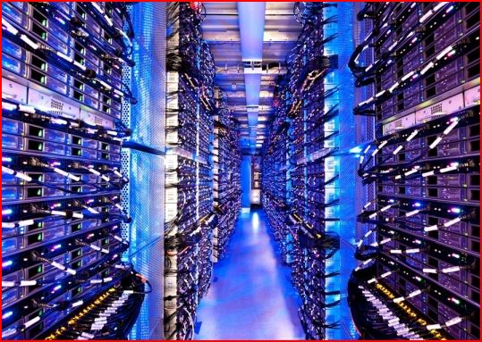

Cloud Computing contd.
A cloud infrastructure provides a framework to manage scalable, reliable, on-demand access to applications
A cloud is the “invisible” backend to many of our mobile applications
A model of computation and data storage based on “pay as you go” access to “unlimited” remote data center capabilities

Slide 11
Cloud Computing - Examples
Virtual office
Hospitals and healthcare facilities

Slide 12
Internet and Web technology
Internet refers to network of networks
In this network each computer is recognized by a globally unique address known as IP address
A special computer DNS (Domain Name Server) is used to give name to the IP Address so that user can locate a computer by a name
For example, a DNS server will resolve a name http://www.xyz.com to a particular IP address to uniquely identify the computer on which this website is hosted

Slide 13
Summary
Network computers are the computers that are connected to each other through a network
A distributed system is one in which components located at networked computers communicate and coordinate their actions only by passing messages
High Performance Computing (HPC) allows scientists and engineers to solve complex, compute-intensive problems
Cloud Computing refers to manipulating, configuring, and accessing the applications online
Internet refers to network of networks
In this network each computer is recognized by a globally unique address known as IP address

Slide 14
References
computers, H. (2018). How are Network computers different from traditional personal computers - Codereviewz. [online] Codereviewz. Available at: https://www.codereviewz.com/network-computers-different-traditional-personal-computers/ [Accessed 5 Aug. 2018].
Amazon Web Services, Inc. (2018). High Performance Computing (HPC) in the Cloud | Accelerated Computing. [online] Available at: https://aws.amazon.com/hpc/ [Accessed 5 Aug. 2018].

